Slide 1

BE AIML GRP 18
Sales Navigator
NEXT
Tool to have for every sales enthusiast

Slide 2







The team
Sudhanshu SIngh
Kunal Katke
Shubham Jadhav
Imran Khattal

Slide 3

INTRODUCTION
As the world moves towards an increasingly digitized society,people are turning to technology to make informed decisions about their investments.
One such investment is the sales market,and it is important for those looking to invest to have access to accurate predictions of future sales prices.
Our Machine Learning model is one such prediction tool that has been found to be particularly accurate when predicting changes in sales prices.
The model is based on a set of historical data points, and it uses a variety of algorithms to predict future trends.

Slide 4


Methodology
STEPS TO PROJECT
By following this simplified methodology, we can efficiently leverage deep learning transformer models to predict sales with a focus on the key stages of dataset preparation, pre-processing, data splitting, model building, and result prediction.

Slide 5
Development Process
1
2
3
4
Data Collection and Aggregation
Data Pre-processing
Feature Engineering
Data Splitting
5
6
7
Model Development
Model Testing
FInal Product

Slide 6


TRANSFORMER
Self-Attention Mechanism
Self-attention enables transformers to weigh the importance of different input tokens when processing a particular token, thereby capturing long-range dependencies efficiently. This mechanism allows transformers to process sequences in parallel, unlike recurrent neural networks (RNNs) which process them sequentially.
Encoder-Decoder Structure
Transformers are often structured as encoder-decoder models. In tasks like machine translation, the encoder processes the input sequence, while the decoder generates the output sequence. Each encoder and decoder layer typically consists of multiple self-attention sub-layers followed by feedforward neural networks.

Slide 7
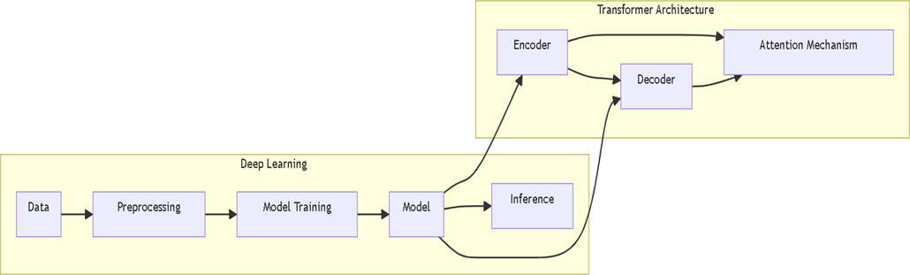
Architecture

Slide 8


OUR
RESULTS
User Input Handling:
Users can input a sales symbol and specify the number of days to predict.
Transformer Model Construction and Training:
The application constructs a transformer model for predicting future stock prices and trains it on pre-processed data.
Real-time Data Retrieval:
The application fetches real-time stock price data using the yfinance library, ensuring up-to-date information for analysis.
Display of Forecasted Prices:
The forecasted sales prices are displayed to the user in a clear and comprehensible manner.
Efficient & Accurate :
The code processes sales price data promptly without delays, ensuring precise and reliable insights into future sales prices.
Precise Prediction:
Utilizing the trained model, the application accurately predicts future sales prices.

Slide 9



Conclusion
This project entails the creation of a web application dedicated to predicting market sales prices.
Employing a systematic approach, we have adopted Extreme Programming, a methodology under the Agile development framework, to guide our efforts.
Utilizing the Streamlit framework, we have developed the application.
ur focus has been on delivering a sophisticated prototype capable of accurately predicting sales prices using Transformers technology.
Thorough testing has been conducted to validate the quality and performance of the implemented software.

